Slide 1

Case Study
GIOZA

Slide 2
Energy Consumption

Slide 3
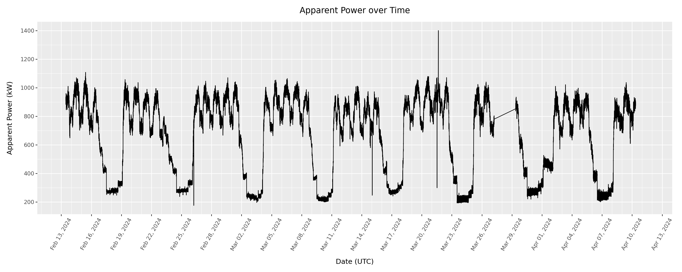
Data Preparation and Visualization
Changed ‘at’ into DateTime Variable and sort date by DateTime (with Interval = 1 minute)
4 anomalies: 5:00 on Feb 26, 24; 1:00 on Mar 15, 24; 13:00 & 16:00 on Mar 21, 24
Using past 30 minutes of energy consumption to predict 5 minutes into the future

Slide 4
Energy Analysis (1)
Analyzed data using 4 different models: Linear, Tree (5), Forest (5), RNN (20)
Linear is the best performing model: Lag 1 and 2 are the most important
Importance | Linear | Tree | Forest | RNN
Training MSE | 21.69 | 23.19 | 25.51 | 24.55
Testing MSE | 24.16 | 26.08 | 25.29 | 27.28
1st | Lag 1 (0.589) | Lag 1 (0.996) | Lag 1 (0.904)
2nd | Lag 2 (0.113) | Lag 2 (0.004) | Lag 2 (0.096)
3rd | Lag 3 (0.082) | Anything else | Anything else
4th | Lag 8 (0.054) | Anything else | Anything else
5th | Lag 4 (0.052) | Anything else | Anything else

Slide 5
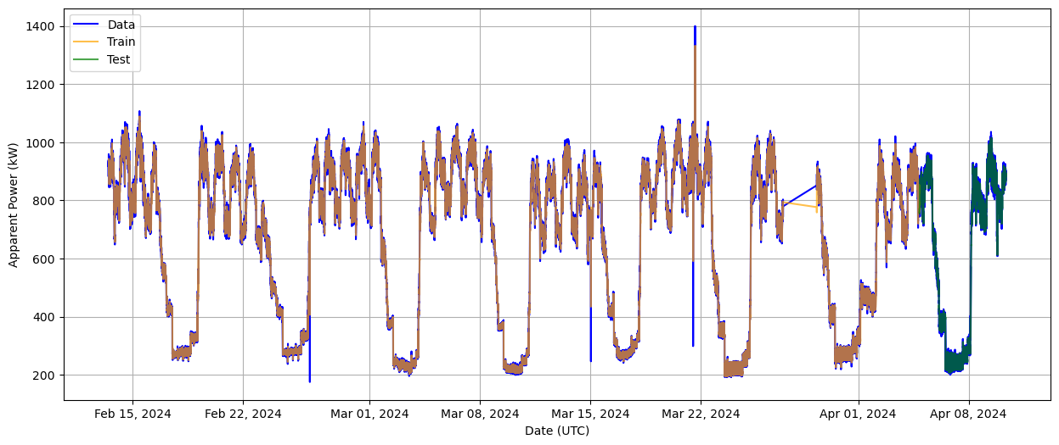
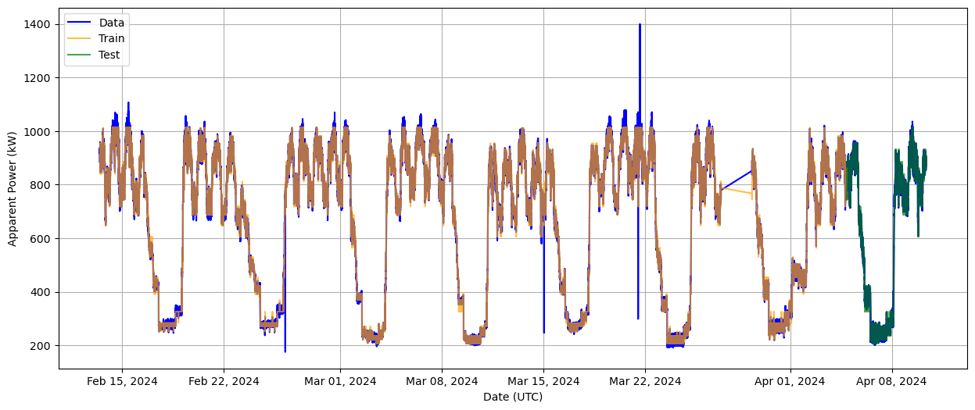

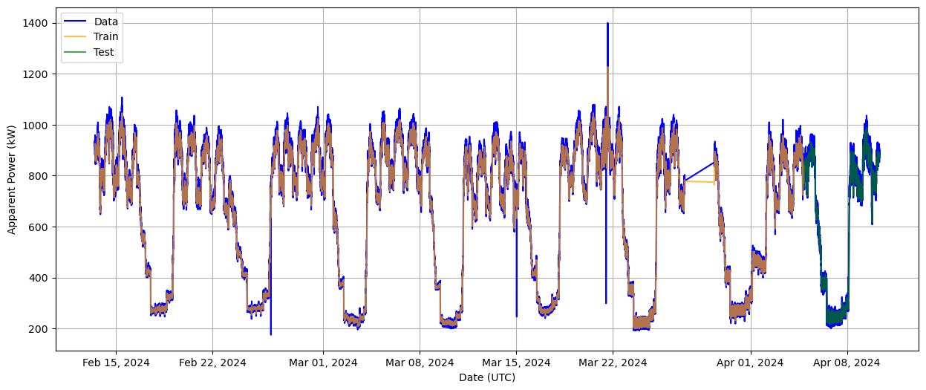
Energy Analysis (2)
Linear
Tree
Forest
RNN

Slide 6
Temperature Consumption

Slide 7
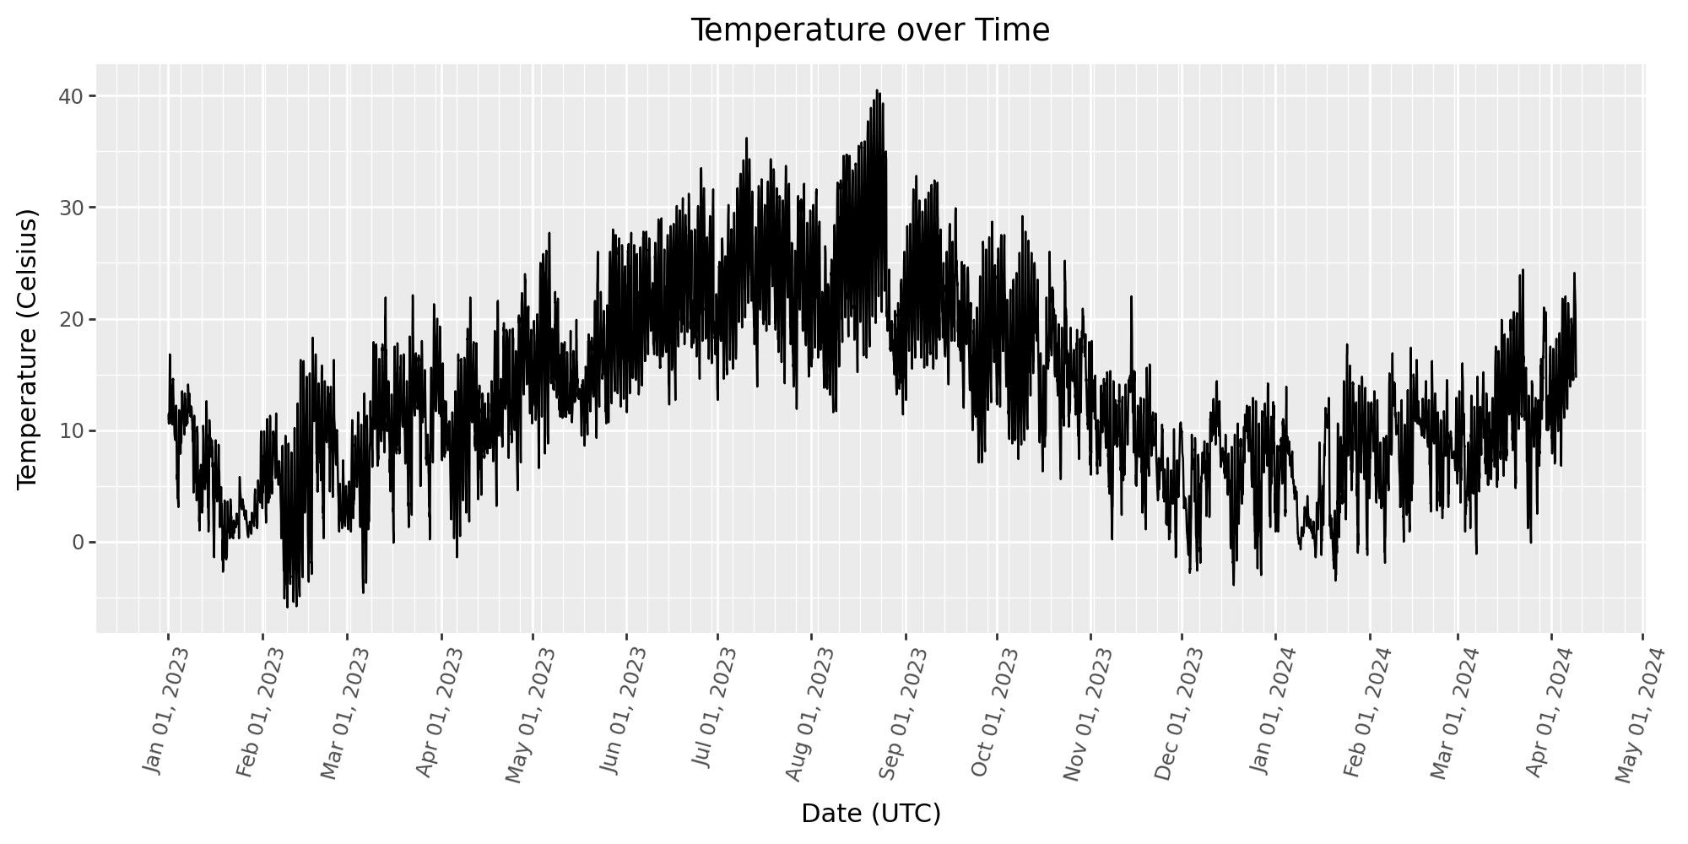
Data Preparation and Visualization
Changed ‘at’ into DateTime Variable and sort date by DateTime (with Interval = 1 hour)
Using past 12 hours of temperature consumption to predict 3 hours into the future

Slide 8
Temperature Analysis (1)
Analyzed data using 4 different models: Linear, Tree (5), Forest (5), RNN (20)
Linear is the best performing model: Lag 1 is the most important
Importance | Linear | Tree | Forest | RNN
Training MSE | 2.26 | 2.69 | 2.46 | 3.27
Testing MSE | 2.20 | 2.75 | 2.51 | 2.93
1st | Lag 1 (1.867) | Lag 1 (0.959) | Lag 1 (0.959)
2nd | Lag 2 (-0.684) | Lag 12 (0.011) | Lag 12 (0.009)
3rd | Lag 12 (0.515) | Lag 5 (0.009) | Lag 5 (0.009)
4th | Lag 3 (-0.255) | Lag 3 (0.008) | Lag 3 (0.008)
5th | Lag 11 (-0.253) | Lag 8 (0.004) | Lag 4 (0.005)

Slide 9
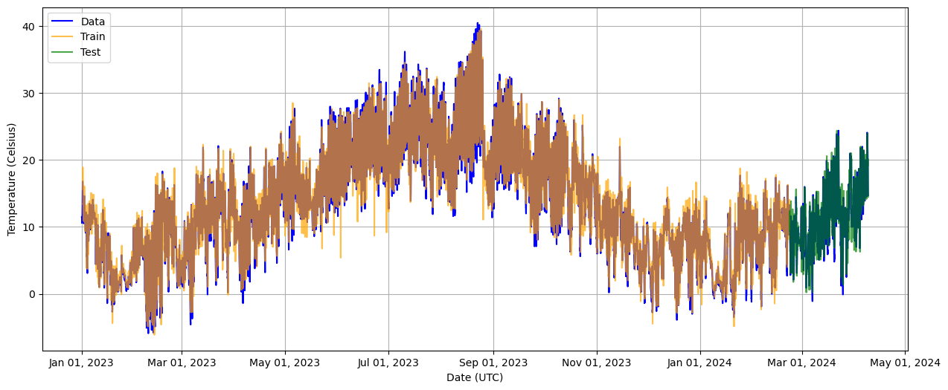
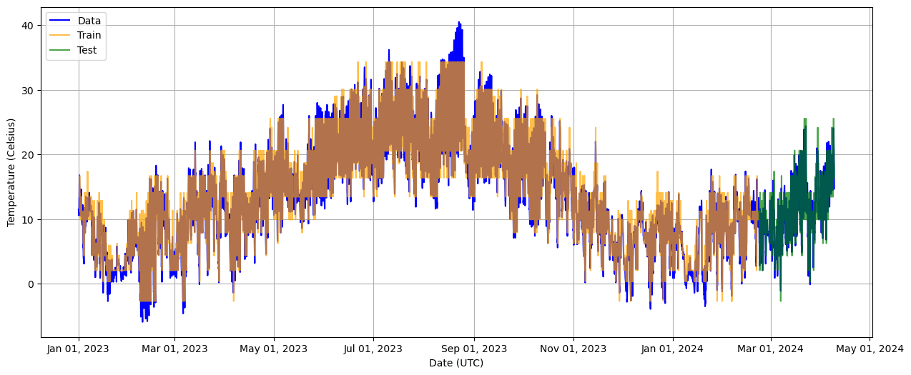
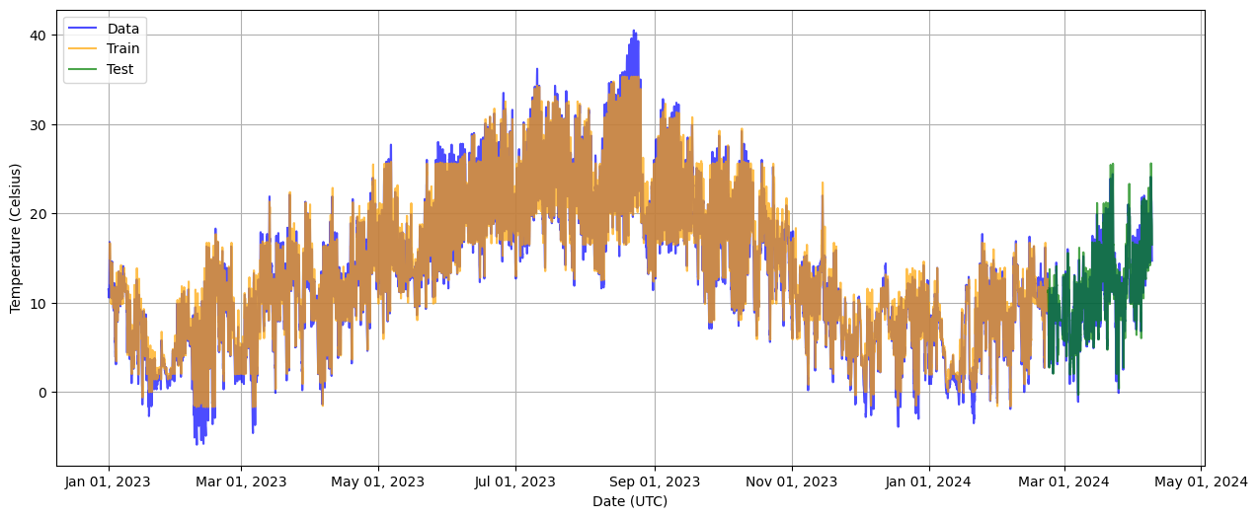
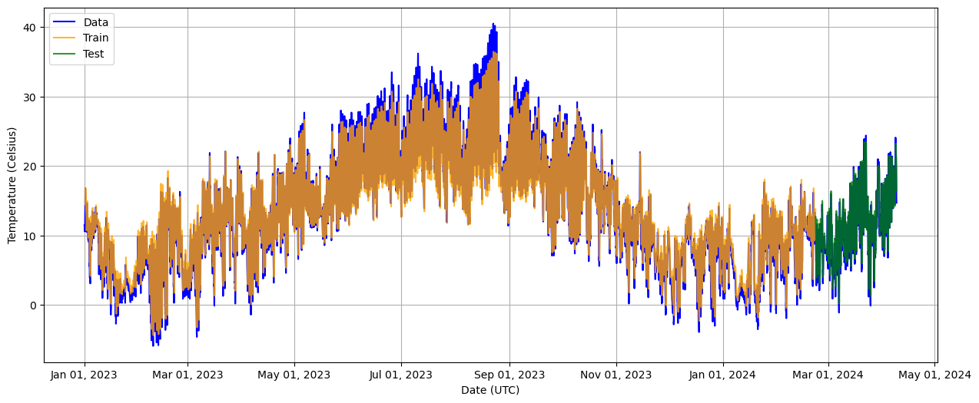
Temperature Analysis (2)
Linear
Tree
Forest
RNN

Slide 10
Production Consumption

Slide 11
Data Preparation and Tables
Group | Count | Mean Units | Mean Weight | Mean Scrap
4G100100 | 463 | 76805.62 | 90.34 | 1174.95
4G100110 | 84 | 63476.19 | 223.77 | 1869.05
4G100410 | 146 | 55332.1 | 191.66 | 0
4G100420 | 279 | 98369.18 | 135.2 | 376.34
4G110120 | 70 | 63500 | 90.08 | 214.29
4G110160 | 148 | 61317.57 | 176.66 | 858.11
4G120110 | 252 | 131384.92 | 165.2 | 1071.43
4G120120 | 257 | 117645.91 | 171.33 | 953.31
4G120300 | 252 | 121289.68 | 175.38 | 555.56
4G120410 | 238 | 135563.03 | 170.87 | 0
4G120420 | 241 | 124771.78 | 181.61 | 580.91
4G130110 | 481 | 45282.74 | 130.83 | 931.4
4G130120 | 298 | 72318.79 | 122.07 | 365.77
4G130130 | 311 | 38241.16 | 220.76 | 382.64
4G130160 | 666 | 39067276.62 | 227.34 | 0
4G130300 | 556 | 86520.42 | 167.7 | 136.69
4G130310 | 331 | 43122.86 | 301.88 | 120.85
4G130400 | 1230 | 52024.1 | 146.57 | 16.26
4G130410 | 114 | 38807.02 | 435.46 | 43.86
4G140120 | 297 | 28565.66 | 327.12 | 313.13
4G140150 | 36 | 19361.11 | 372.88 | 208.33
4G140400 | 335 | 25536.33 | 316.28 | 74.63
4G200100 | 267 | 16128354.2 | 1221.87 | 0
4G200140 | 212 | 375452.83 | 375.45 | 0
4G200150 | 1483 | 6412.52 | 24.66 | 2.24
4G200160 | 267 | 38387.48 | 218.55 | 69.09
4G200180 | 68 | 7854.85 | 45.9 | 35.93
Changed ‘at’ into DateTime Variable and sort date by DateTime (with Interval = random)
‘Poste de travail’ , ‘Centre de coûts’, and ‘sku’ are changed into strings / groups

Slide 12
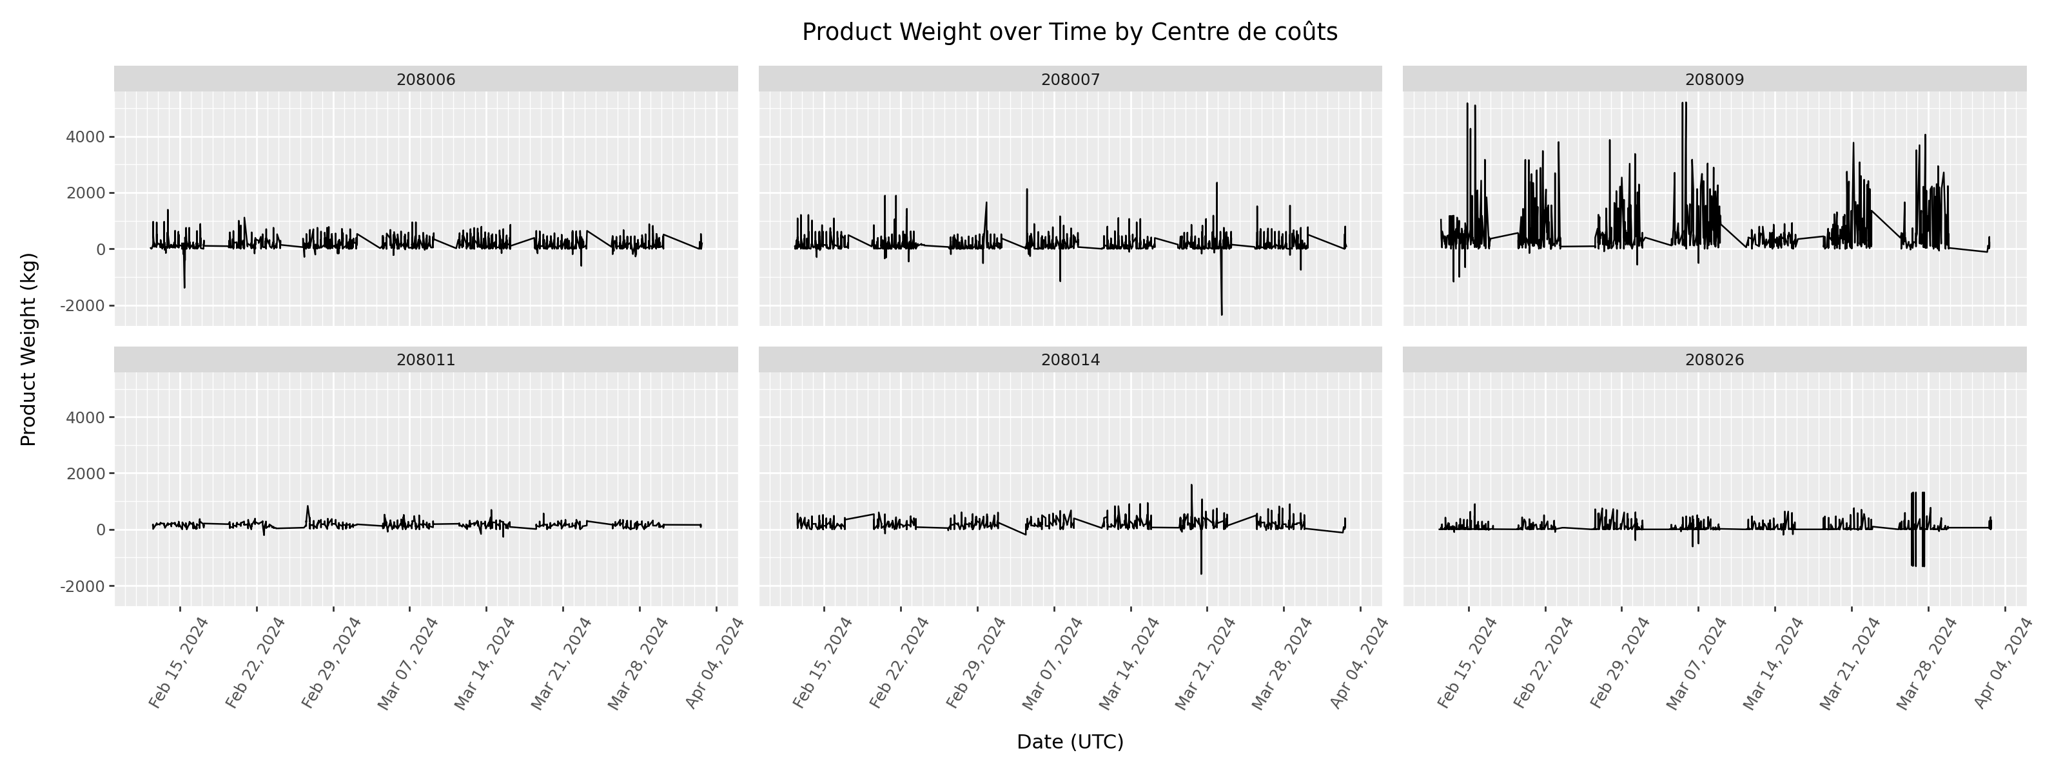
Production Weight by Centre de coûts
Centre de coûts | Count | Mean Units | Mean Weight | Mean Scrap
208006 | 2173 | 54346.07 | 170.52 | 736.08
208007 | 2104 | 53465.69 | 190.87 | 73.67
208009 | 1145 | 26554299.39 | 486.68 | 0
208011 | 1255 | 125074.1 | 171.61 | 649.4
208014 | 887 | 70325.84 | 217.77 | 130.78
208026 | 1818 | 11162.46 | 53.93 | 13.32

Slide 13
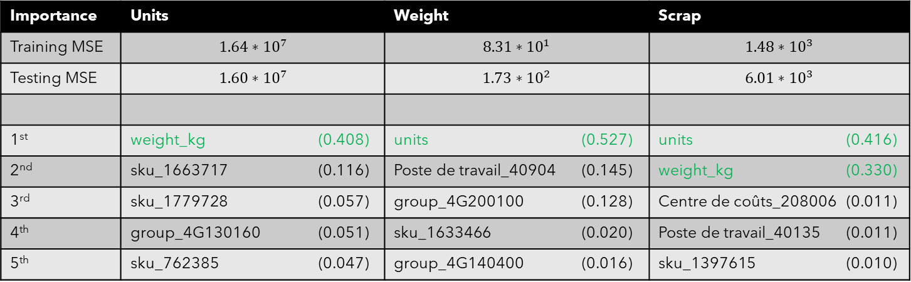
Production Analysis
Analyzed data using 2 different models: Tree (5), Forest (5): Both not accurate
Units, Weight, Scrap production are greater indicators of one another (↑ Unit = ↑ Weight = ↑ Scrap)
Units’ Influence: some sku >> group, Poste de travail, Centre de coûts
Weight’s Influence: some groups >> some sku >> Poste de travail, Centre de coûts
Scrap’s Influence: units, weights >> sku, group, Poste de travail, Centre de coûts
Importance | Units | Weight | Scrap
Training MSE | $$1.64∗{10}^{7}$$ | $$8.31∗{10}^{1}$$ | $$1.48∗{10}^{3}$$
Testing MSE | $$1.60∗{10}^{7}$$ | $$1.73∗{10}^{2}$$ | $$6.01∗{10}^{3}$$
1st | weight_kg (0.408) | units (0.527) | units (0.416)
2nd | sku_1663717 (0.116) | Poste de travail_40904 (0.145) | weight_kg (0.330)
3rd | sku_1779728 (0.057) | group_4G200100 (0.128) | Centre de coûts_208006 (0.011)
4th | group_4G130160 (0.051) | sku_1633466 (0.020) | Poste de travail_40135 (0.011)
5th | sku_762385 (0.047) | group_4G140400 (0.016) | sku_1397615 (0.010)

Slide 14
Summary
Energy consumption is most influenced by the most recent known apparent power and any power past 2 minutes has little to no influence.
Temperature consumption is most influenced by the most recent known temperatures, but temperatures within 3 hours can be used to predict future Temperature still somewhat well.
Units, weights, and scraps consumption generally imply one another and are generally influenced by their groups and sku rather than Poste de travail and Centre de coûts.

